Slide 1
CS 33 – Discussion 1A Computer System Organization
Week 3

Slide 2
Questions before we start?

Slide 3
Logistics
Lab 1 - Datalab due tonight 11:59pm
Lab 2 – Bomb lab released tomorrow – Due Friday May 1st 11:59
Probably have HW 2 assigned and due before then
Please submit suggestions on CCLE TA-site on how to improve OH or DISC

Slide 4
Agenda
10am-11am PST:
x86-64 basics continued
Condition codes
Conditional Branching
Switch statements/Jump tables
Structs/Data alignment
Register saving conventions
Recursion/Tail Recursion code example
11am-11:50am PST:
LA worksheet

Slide 5
Agenda
If time permits:
Detail Bomblab
Answer questions on Datalab

Slide 6
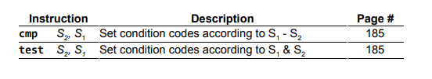
x86-64 Basics – Condition codes
Condition codes are set implicitly by arithmetic instructions
Explicitly set by setX instructions or cmp/test instruction
Can be thought of as single bit registers

Slide 7
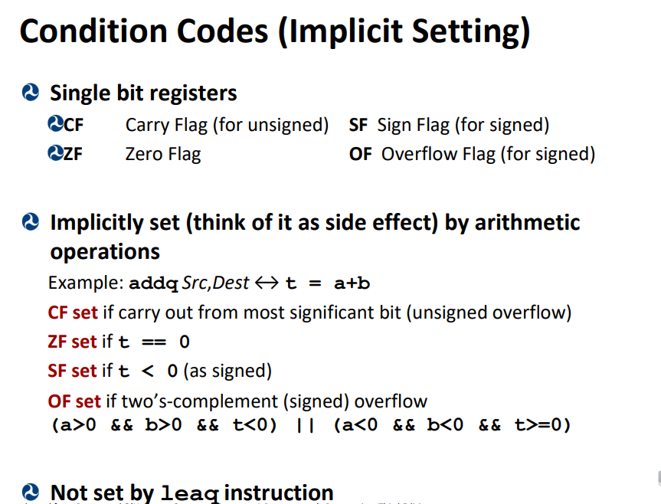
x86-64 Basics – Condition codes

Slide 8
x86-64 Basics – Condition codes

Slide 9
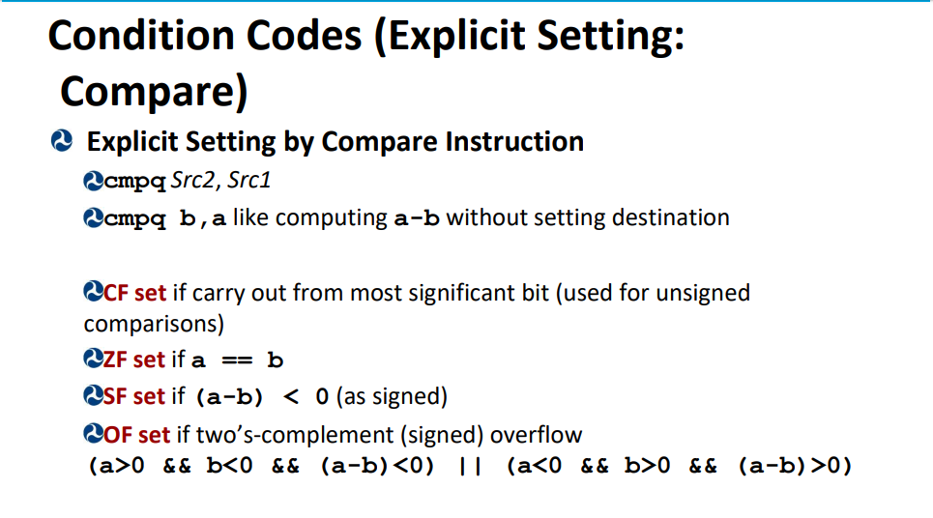
x86-64 Basics – Condition codes

Slide 10
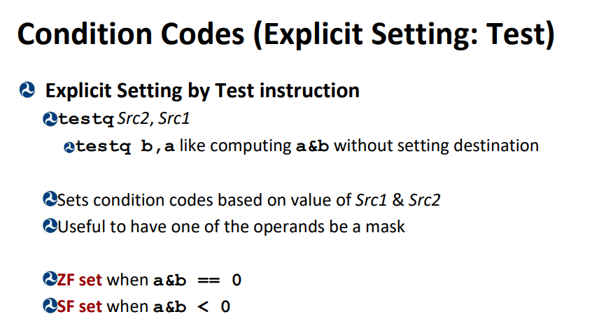
x86-64 Basics – Condition codes

Slide 11
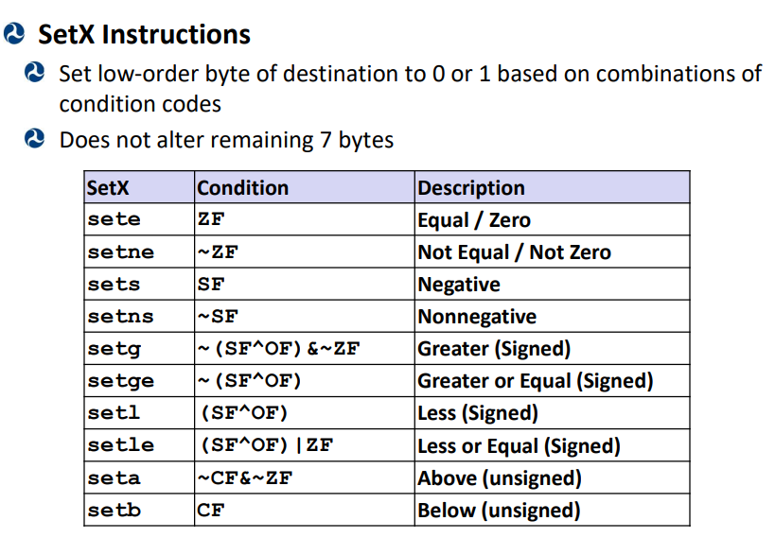
x86-64 Basics – Condition codes

Slide 12
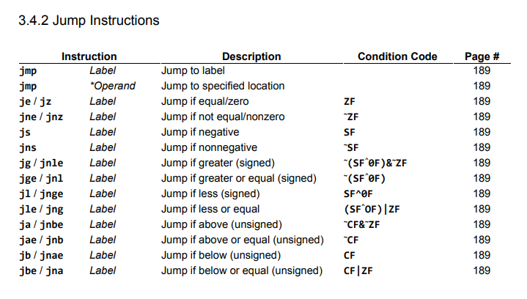
x86-64 Basics – Conditional Branching

Slide 13
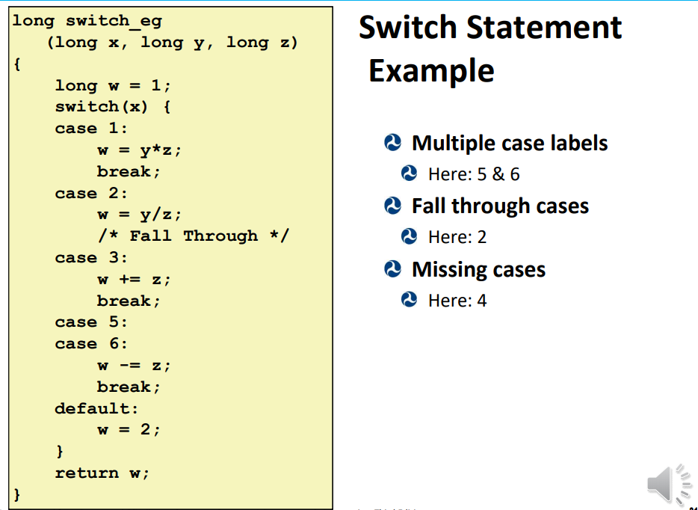
x86-64 Basics – Switch Statement

Slide 14
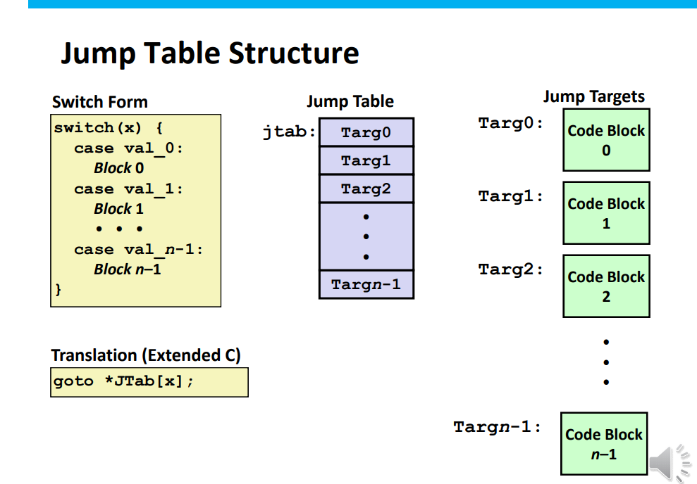
x86-64 Basics – Switch Statement

Slide 15
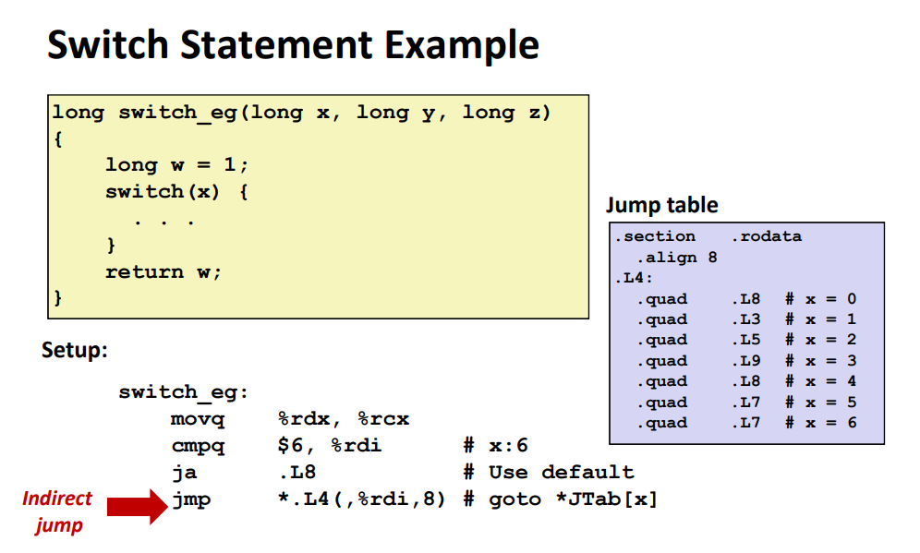
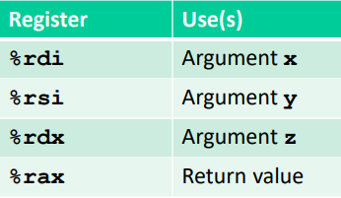
x86-64 Basics – Switch Statement

Slide 16
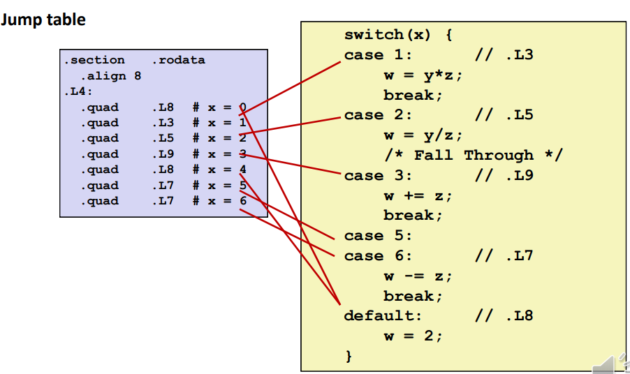
x86-64 Basics – Switch Statement

Slide 17
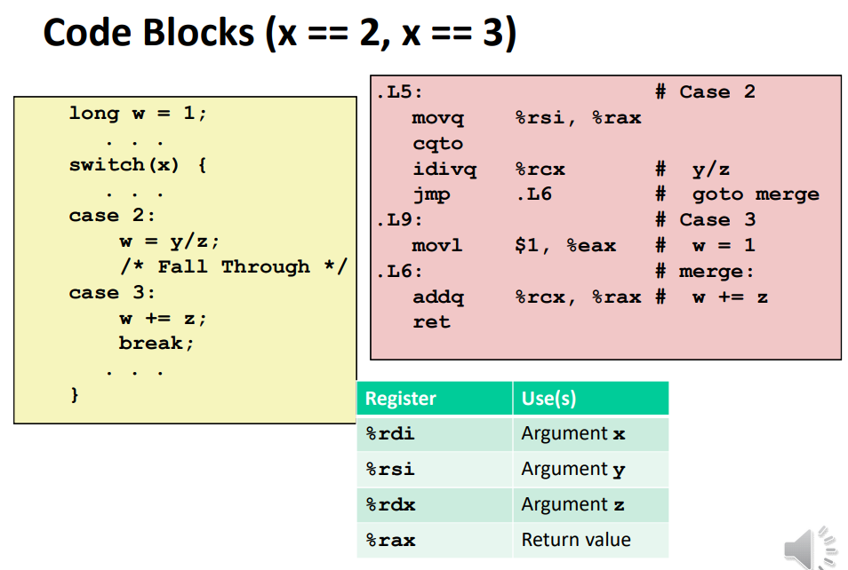
x86-64 Basics – Switch Statement

Slide 18
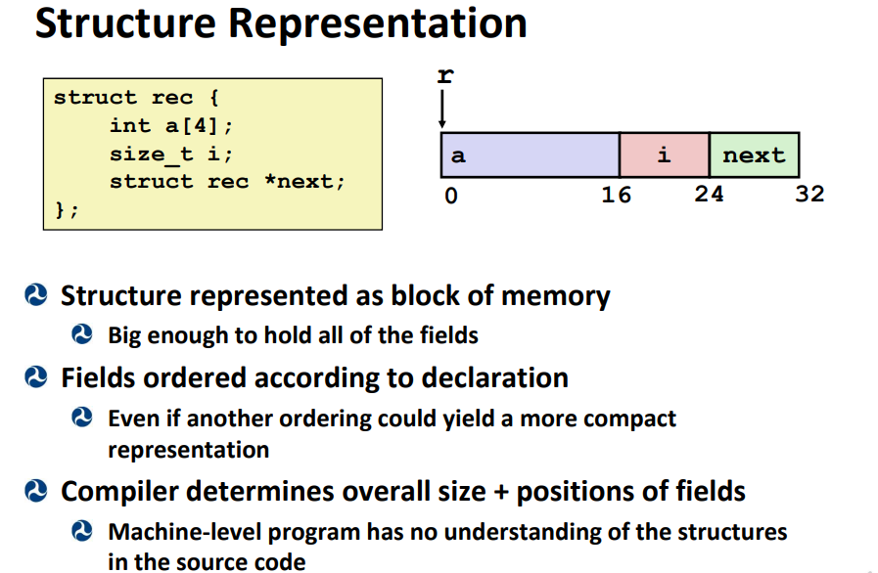
x86-64 Basics – Structs/Data align

Slide 19
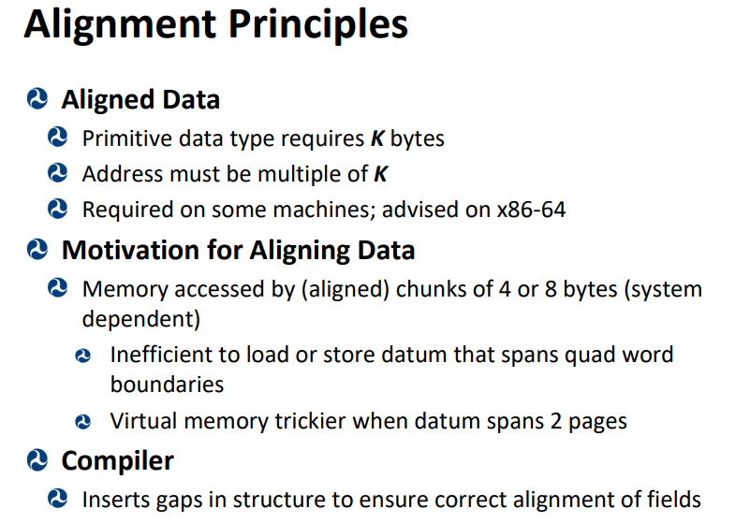
x86-64 Basics – Structs/Data align

Slide 20
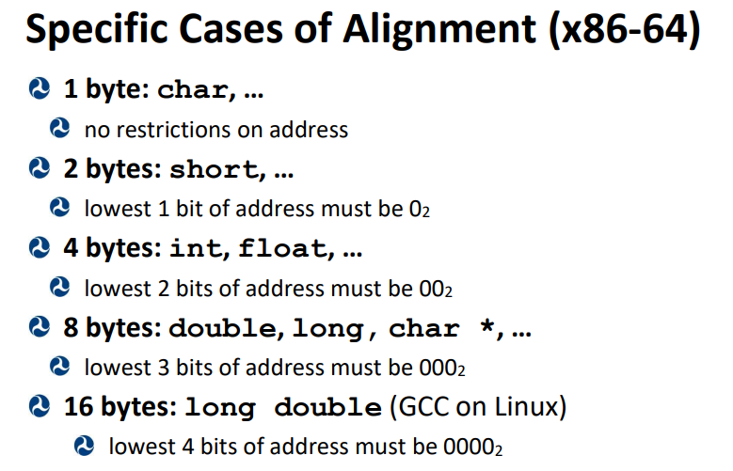
x86-64 Basics – Structs/Data align

Slide 21
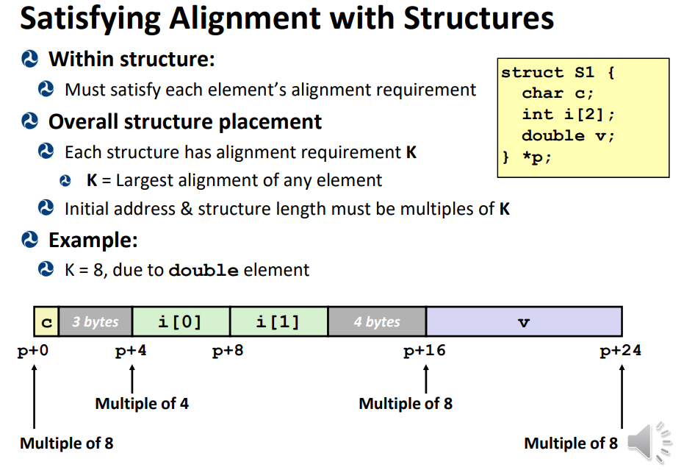
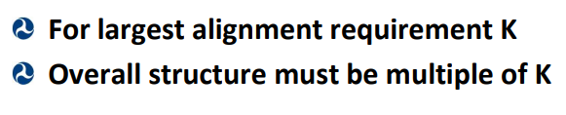
x86-64 Basics – Structs/Data align

Slide 22
x86-64 Basics – Structs/Data align

Slide 23
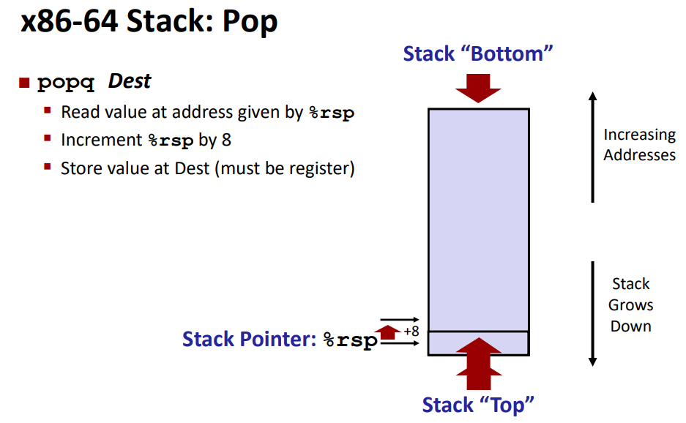
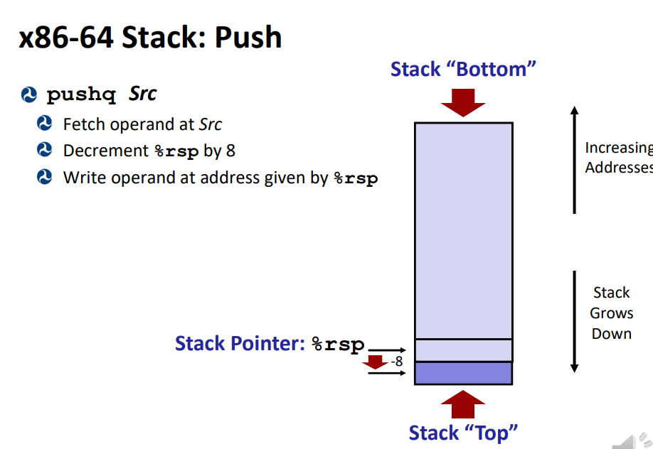
x86-64 Basics – Calling Convention
Stack is LIFO data struct
Contains the history of function calls

Slide 24
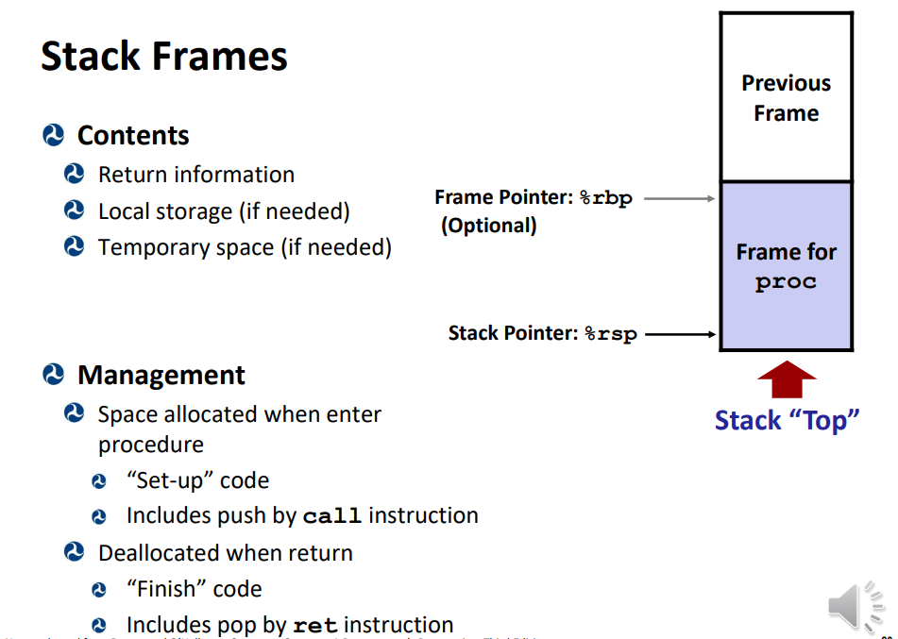
x86-64 Basics – Calling Convention

Slide 25
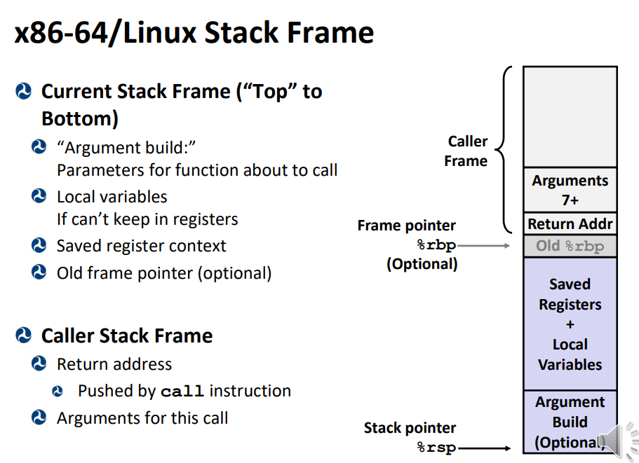
x86-64 Basics – Calling Convention

Slide 26
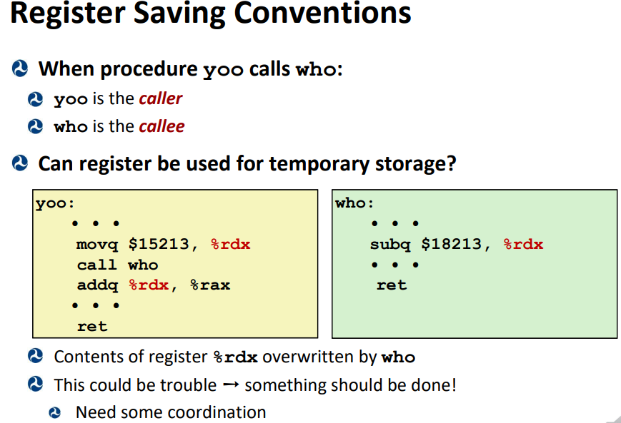
x86-64 Basics – Calling Convention

Slide 27
x86-64 Basics – Calling Convention

Slide 28
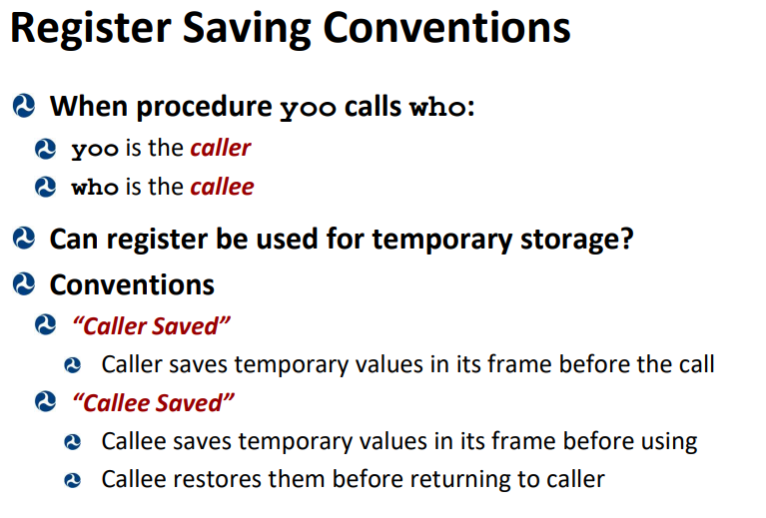
x86-64 Basics – Calling Convention

Slide 29
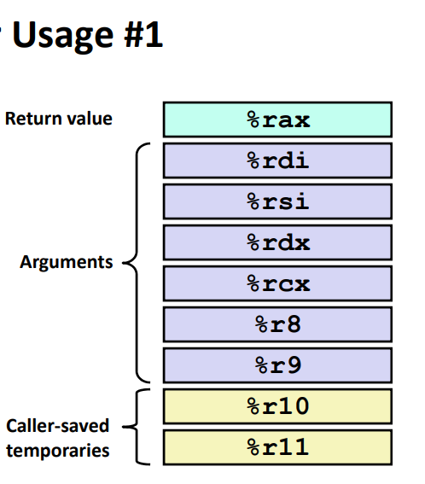
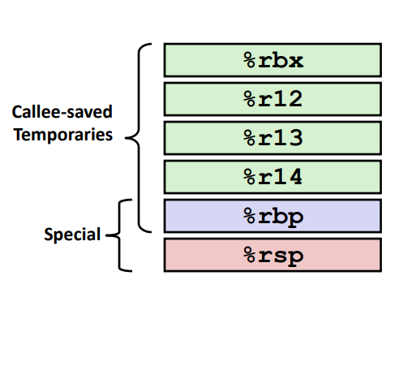
x86-64 Basics – Calling Convention
Calle-saved usage
Caller Saved usage

Slide 30
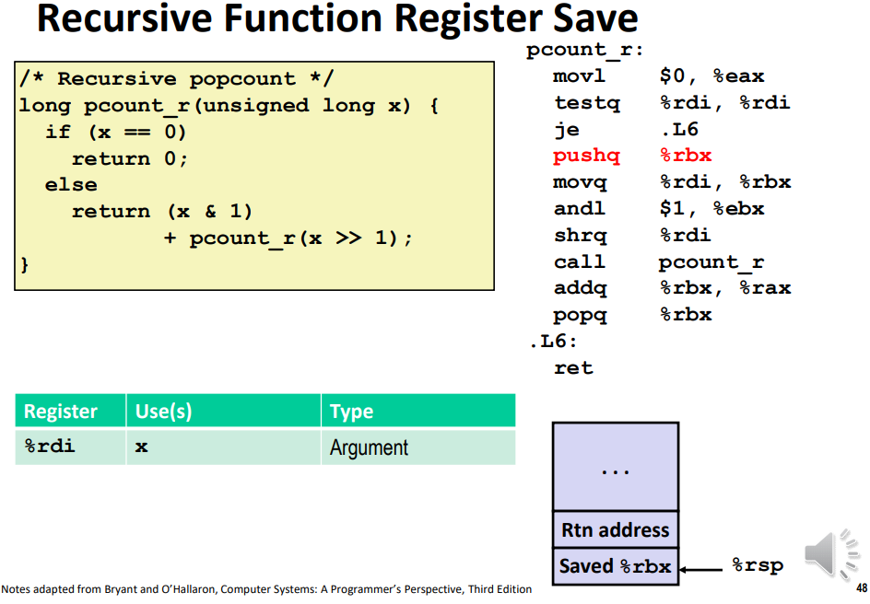
x86-64 Basics – Recursion
Calle-saved usage
Caller Saved usage

Slide 31
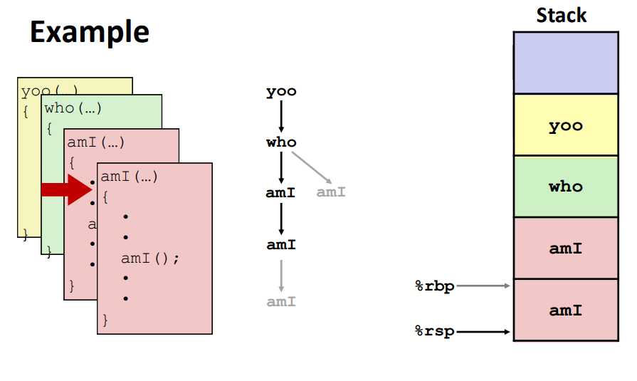
x86-64 Basics – Recursion
A potential problem: stack overflow
To reduce the chance of stack overflow:
Tail-recursion: make the last instruction in the function be the recursive call (last instruction is the function calling itself)
Tail recursive function calls don’t need to return to caller, since there’s nothing left in the caller to be handled.
No need to store the caller’s address
No need to store different stack frames for each invocation
Saves tons of space on stack
Example of stack with regular function calls, can easily overload with stack frames :

Slide 32
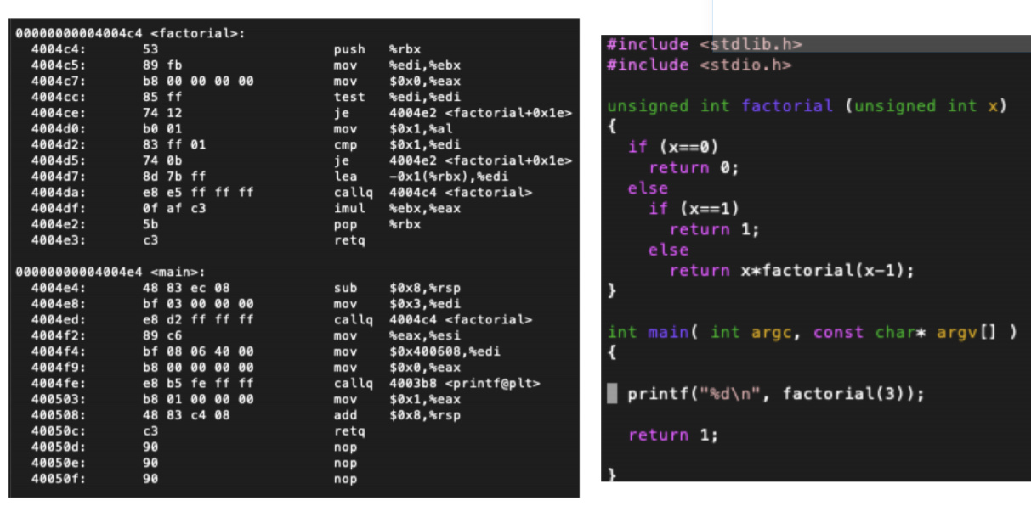
x86-64 Basics – Recursion
How do we make this function tail recursive?
What does the stack look like in regular / tail recursive example?
Lets investigate!
Compiler should optimize recursion into loop

Slide 33
Questions before we start worksheet?

Slide 34
Resources used
https://cs.brown.edu/courses/cs033/docs/guides/x64_cheatsheet.pdf
https://cs.stackexchange.com/questions/76871/how-are-variables-stored-in-and-retrieved-from-the-program-stack
https://www.geeksforgeeks.org/memory-layout-of-c-program/
https://vim.rtorr.com/
https://www.tenouk.com/ModuleW.html
Professor Reinman’s slides (CCLE)
Credit for slides: Attiano Purpura-Potoniere

